Slide 1
CONVOLUTIONAL NEURAL NETWORKS

Slide 2
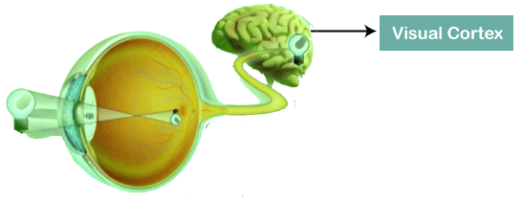
Convolutional Neural Network:
Convolutional Neural Networks are a special type of feed-forward artificial neural network in which the connectivity pattern between its neuron is inspired by the visual cortex.

Slide 3
The visual cortex encompasses a small region of cells that are region sensitive to visual fields.
In case some certain orientation edges are present then only some individual neuronal cells get fired inside the brain such as some neurons responds as and when they get exposed to the vertical edges, however some responds when they are shown to horizontal or diagonal edges, which is nothing but the motivation behind Convolutional Neural Networks.
The Convolutional Neural Networks, which are also called as covnets, are nothing but neural networks, sharing their parameters.
Suppose that there is an image, which is embodied as a cuboid, such that it encompasses length, width, and height. Here the dimensions of the image are represented by the Red, Green, and Blue channels, as shown in the image given below.

Slide 4
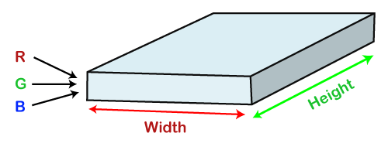
Now assume that we have taken a small patch of the same image, followed by running a small neural network on it, having k number of outputs, which is represented in a vertical manner. Now when we slide our small neural network all over the image, it will result in another image constituting different width, height as well as depth. We will notice that rather than having R, G, B channels, we have come across some more channels that, too, with less width and height, which is actually the concept of Convolution. In case, if we accomplished in having similar patch size as that of the image, then it would have been a regular neural network. We have some wights due to this small patch.

Slide 5
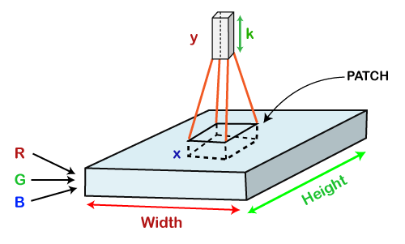

Slide 6
Mathematically it could be understood as follows:
The Convolutional layers encompass a set of learnable filters, such that each filter embraces small width, height as well as depth as that of the provided input volume (if the image is the input layer then probably it would be 3).
Suppose that we want to run the convolution over the image that comprises of 34x34x3 dimension, such that the size of a filter can be axax3. Here a can be any of the above 3, 5, 7, etc. It must be small in comparison to the dimension of the image.
Each filter gets slide all over the input volume during the forward pass. It slides step by step, calling each individual step as a stride that encompasses a value of 2 or 3 or 4 for higher-dimensional images, followed by calculating a dot product in between filter's weights and patch from input volume.
It will result in 2-Dimensional output for each filter as and when we slide our filters followed by stacking them together so as to achieve an output volume to have a similar depth value as that of the number of filters. And then, the network will learn all the filters.

Slide 7
Working of CNN:
Generally, a Convolutional Neural Network has three layers, which are as follows;
Input: If the image consists of 32 widths, 32 height encompassing three R, G, B channels, then it will hold the raw pixel([32x32x3]) values of an image.
Convolution: It computes the output of those neurons, which are associated with input's local regions, such that each neuron will calculate a dot product in between weights and a small region to which they are actually linked to in the input volume. For example, if we choose to incorporate 12 filters, then it will result in a volume of [32x32x12].
ReLU Layer: It is specially used to apply an activation function elementwise, like as max (0, x) thresholding at zero. It results in ([32x32x12]), which relates to an unchanged size of the volume.
Pooling: This layer is used to perform a downsampling operation along the spatial dimensions (width, height) that results in [16x16x12] volume.

Slide 8
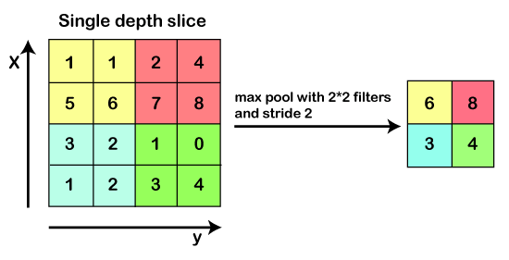

Slide 9
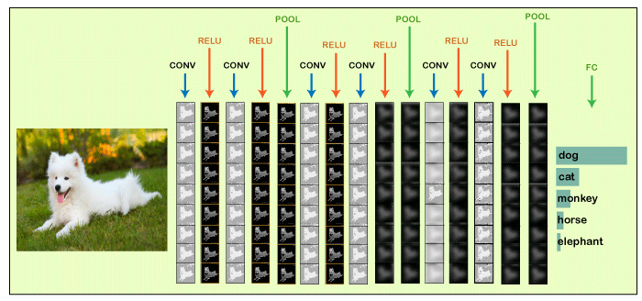
Locally Connected: It can be defined as a regular neural network layer that receives an input from the preceding layer followed by computing the class scores and results in a 1-Dimensional array that has the equal size to that of the number of classes.

Slide 10
We will start with an input image to which we will be applying multiple feature detectors, which are also called as filters to create the feature maps that comprises of a Convolution layer.
Then on the top of that layer, we will be applying the ReLU or Rectified Linear Unit to remove any linearity or increase non-linearity in our images.
Next, we will apply a Pooling layer to our Convolutional layer, so that from every feature map we create a Pooled feature map as the main purpose of the pooling layer is to make sure that we have spatial invariance in our images.
It also helps to reduce the size of our images as well as avoid any kind of overfitting of our data.
After that, we will flatten all of our pooled images into one long vector or column of all of these values, followed by inputting these values into our artificial neural network. Lastly, we will feed it into the locally connected layer to achieve the final output.

Slide 11
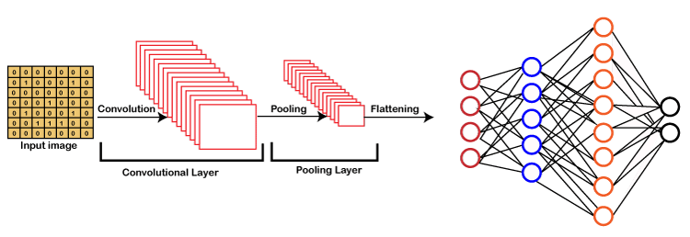

Slide 12
Building a CNN:
Basically, a Convolutional Neural Network consists of adding an extra layer, which is called convolutional that gives an eye to the Artificial Intelligence or Deep Learning model because with the help of it we can easily take a 3D frame or image as an input as opposed to our previous artificial neural network that could only take an input vector containing some features as information.
But here we are going to add at the front a convolutional layer which will be able to visualize images just like humans do
In our dataset, we have all the images of cats and dogs in training as well as in the test set folders. We are going to train our CNN model on 4000 images of cats as well as 4000 images of dogs, each respectively that are present in the training set followed by evaluating our model with the new 1000 images of cats and 1000 images of dogs, each respectively in the test set on which our model was not trained. So, we are actually going to build and train a Convolutional Neural network to recognize if there is a dog or cat in the image.

Slide 13
For the implementation of CNN, we are going to use the Jupyter notebook. So, we will start with importing the libraries, data preprocessing followed by building a CNN, training the CNN and lastly, we will make a single prediction. All the steps will be carried out in the same way as we did in ANN, the only difference is that now we are not pre-processing the classic dataset, but some images, which is why the data preprocessing is different and will consist of doing two steps, i.e., in the first, we will pre-process the training set and then will pre-process the test set.
In the second part, we will build the whole architecture of CNN. We will initialize the CNN as a sequence of layers, and then we will add the convolution layer followed by adding the max-pooling layer. Then we will add the second convolutional layer to make it a deep neural network as opposed to a shallow neural network. Next, we will proceed to the flattening layer to flatten the result of all the convolutions and pooling into a one-dimensional vector, which will become the input of a fully connected neural network. Finally, we will connect all this to the output layer.
In the third part, we will first compile the CNN, and then we will train the CNN on the training set. And then, finally, we will make a single prediction to test our model in a prediction that is when we will deploy our CNN on to different images, one that has a dog and the other that has a cat.

Slide 14
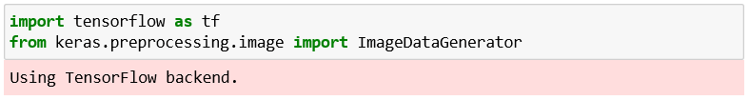
So, this was just a brief description of how we will build our CNN model, let's get started with its practical implementation.
We will start by importing the TensorFlow library and actually the preprocessing module by Keras library. And then, we will import the image sub-module of the preprocessing module of the Keras library, which will allow us to do image pre-processing in part 1.
import tensorflow as tf
from keras.preprocessing.image import ImageDataGenerator
Output:
It can be seen that we have successfully run our first cell from the image given above. Using TensorFlow backend, which is the output of the first cell, and in order for this to work this way, we have to make sure to run pip install commands of TensorFlow and Keras.

Slide 15
Next, we will check the version of the TensorFlow.
tf.__version__
Output:
It can be seen that the version of TensorFlow is 2.0.0.
After this, we will move on to Part1: Data Pre-processing, which will be done in two steps, i.e., firstly, we will preprocess the training set, and secondly, we will preprocess the test set.

Slide 16
Part1: Data Pre-processing:
Preprocessing the Training set
We will apply some transformations on all the images of the training set but not on the images of the test set, so as to avoid overfitting. Indeed, if we don't apply these transformations while training our CNN on the training set, we will get a huge difference between the accuracy on the training set and the one on the test set.
For the computer vision, the way to avoid overfitting is to apply the transformations, which are nothing but a simple geometrical transformation or some zoom or some rotations on the images. So, basically, we are going to apply some geometrical transformations to shift some of the pixels followed by rotating a bit the images, we will be doing some horizontal flips, zoom in as well as zoom out. We are actually going to apply some series of transformations to modify the images and get them augmented, which is called image augmentation. It actually consists of transforming the images of the training set so that our CNN model doesn't overlearn.

Slide 17
We will create an object of train_datagen of the ImageDataGenerator class that represents the tool that will apply all the transformations on the images of the training set, such that the rescale argument will apply feature scaling to each and every single one the pixel by dividing their value 255 as each pixel take a value between 0 and 255, which is really necessary for neural networks and the rest are the transformations that will perform image augmentation on the training set images so as to prevent the overfitting.
train_datagen = ImageDataGenerator(rescale = 1./255,
shear_range = 0.2,
zoom_range = 0.2,
horizontal_flip = True)

Slide 18
After this, we will need to connect the train_datagen object to the training set, and to do this, we will have to import the training set, which can be done as given below. Here training_set is the name of the training set that we are importing in the notebook, and then we indeed take our train_datagen object so as to call the method of ImageDataGenerator class. The method that we will call is the flow_from_directory that will help to connect the image augmentation tool to the image of the training set. we will pass the following parameter;
The first parameter is the path leading to the training set.
The next parameter is the target_size, which is the final size of the images when they will be fed into the convolutional neural network
The third one is the batch_size, which relates to the size of the batches, i.e., the total number of images we want to have in each batch. We have chosen 32, which is the classic default value.
Lastly, we will classify the class mode to be either binary or categorical. Since we are looking for a binary outcome, so will choose binary class mode.

Slide 19
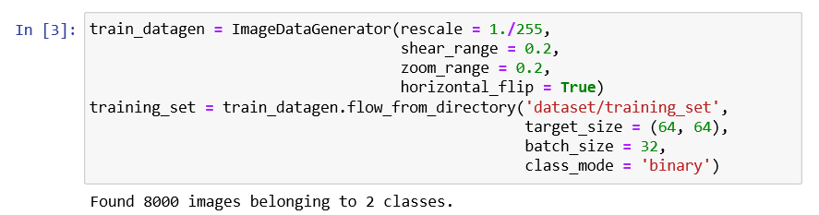
training_set = train_datagen.flow_from_directory('dataset/training_set',
target_size = (64, 64),
batch_size = 32,
class_mode = 'binary')
Output:
After running the above cell, which is Preprocessing the Training Set, we will get in the output from the above image that indeed we imported and preprocessed with the data augmentation; 8000 images belonging to 2 classes, i.e., dogs and cats.

Slide 20
Preprocessing the Test set:
After we are done with preprocessing the training set, we will further move on to preprocessing the test set. We will again take the ImageDataGenerator object to apply transformations to the test images, but here we will not apply the same transformations as we did in the previous step. However, we need to rescale their pixels the same as before because the future predict method of CNN will have to be applied to the same scaling as the one that was applied to the training set.
test_datagen = ImageDataGenerator(rescale = 1./255)
Here test_set is the name of the test set that we are importing in the notebook, and then we indeed take our test_datagen, which will only apply if it is going to the pixels of the test set images. Then we call the same flow_from_directory function to access the test set from the directory. Then we will need to have the same target_size, batch_size, and class_mode as used in the previous step.

Slide 21
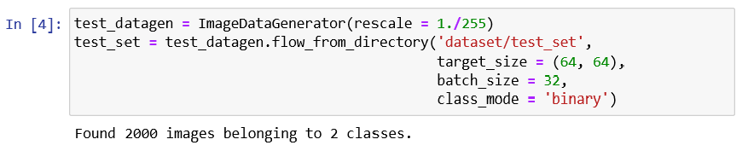
test_set = test_datagen.flow_from_directory('dataset/test_set',
target_size = (64, 64),
batch_size = 32,
class_mode = 'binary’)
Output:
We can see from the above image, which we got after running Preprocessing the Test Set cell, that 2000 images belong to 2 classes. Instead of applying image augmentation, we have only applied feature scaling.

Slide 22
Part2: Building the CNN:
In part two, we are going to build together the convolutional neural network and, more specifically, the whole architecture of the artificial neural network. So, it is actually going to start the same as with our artificial neural network because the convolutional neural network is still a sequence of layers.
Therefore, we are going to initialize our CNN with the same class, which is the sequential class.
Initializing the CNN:
So, this is the first step where we are not only going to call the sequential class but will actually create the cnn variable, which will represent this convolutional neural network. And this cnn variable will be created once again as an instance of that sequential class allows us to create an artificial neural network as a sequence of layers.
First, we will need to call the TensorFlow that has a shortcut tf from which we are going to call Keras library from where we are going to get access to the model's module, or we can say from where we are going to call that sequential class.
cnn = tf.keras.models.Sequential()
After this, we will step by step use the add method to add different layers, whether they are convolutional layers or fully connected layers, and in the end, the output layer

Slide 23
Step1: Convolution
We will first take the cnn object or the convolutional neural network from which we will call the add method to add our very first convolutional layer, which will further be an object of a certain class, i.e., Conv2D class. And this class, just like the dense class that allows us to build a fully connected layer, belongs to the same module, which is the layer module from the Keras library, but this time it is the TensorFlow.
Inside the class, we are going to pass three important parameters, which are as follows:
The first parameter is the filters, which is the number of feature detectors that we want to apply to images for feature detection.
The kernel_size is exactly the size of the feature detector, i.e., the number of rows, which is also the number of columns.
The third one is the activation but here we are not going to keep the default value for the activation parameter corresponding to the activation function, because indeed as long as we don't reach the output layer, we rather want to get a rectifier activation function. That is why we will choose the ReLU parameter name once again as it corresponds to the rectifier activation function.
Lastly, the input_shape parameter because it is necessary to specify the input shape of inputs. Since we are working with the colored images, so the input_shape will be [64, 64, 3].
cnn.add(tf.keras.layers.Conv2D(filters=32, kernel_size=3, activation='relu', input_shape=[64, 64, 3]))

Slide 24
Step2: Pooling
Next, we will move on to applying pooling, and more specifically, if we talk about, we are going to apply the max pooling, and for that, we will again take cnn object from which we are going to call our new method. Since we are adding the pooling layer to our convolutional layer, so we will again call the add method, and inside it, we will create an object of a max-pooling layer or an instance of a certain class, which is called MaxPool2D class. Inside the class, we will pass pool_size and strides parameters.
cnn.add(tf.keras.layers.MaxPool2D(pool_size=2, strides=2))
Adding a second layer
Now we will add our second layer, for which again we have to undergo applying convolutional as well as pooling layer just like we did in the previous step, but here will need to change the input_shape parameter because it is entered only when we add our very first layer to automatically connect that first layer to the input layer, which automatically adds the input layer.
Since we are already here adding the second convolution layer, so we can simply remove that parameter. So, we are all set to move on to step3.
cnn.add(tf.keras.layers.Conv2D(filters=32, kernel_size=3, activation='relu'))
cnn.add(tf.keras.layers.MaxPool2D(pool_size=2, strides=2))

Slide 25
Step3: Flattening
In the third step, we will undergo flattening the result of these convolutions and pooling into a one-dimensional vector, which will become the input of a fully connected layer neural network in a similar way as we did in the previous section. We will start with again taking our cnn object from which we will call the add method because the way we are going to create that flattening layer is once again by creating an instance of the Flatten class, such that Keras will automatically understand that this is the result of all these convolutions and pooling, which will be flattened into the one-dimensional vector.
So, we just need to specify that we want to apply flattening and to do this we will have to call once again the layers module by the Keras library by TensorFlow from which we are actually going to call the flatten class, and we don't need to pass any kind of parameter inside it.
cnn.add(tf.keras.layers.Flatten())

Slide 26
Step4: Full Conversion
In step 4, we are exactly in the same situation as before building a fully connected neural network. So, we will be adding a new fully-connected layer to that flatten layer, which is nothing but a one-dimensional vector that will become the input of a fully connected neural network.
And for this, we will again start by taking a cnn neural network from which we are going to call the add method because now we are about to add a new layer, which is a fully connected layer that belongs to tf.keras.layers. But this time, we will take a Dense class followed by passing units, which is the number of hidden neurons we want to have into this fully connected layer and activation function parameter.
cnn.add(tf.keras.layers.Dense(units=128, activation='relu'))

Slide 27
Step5: Output Layer
Here we need to add the final output layer, which will be fully connected to the previous hidden layer.
Therefore, we will call the Dense class once again in the same way as we did in the previous step but will change the value of the input parameters because the numbers of units in the output layer are definitely not 128.
Since we are doing binary classification, it will actually be one neuron to encode that binary class into a 'cat' or 'dog'. And for the activation layer, it is recommended to have a sigmoid activation function.
Otherwise, if we were doing multiclass classification, we would have used the SoftMax activation function.
cnn.add(tf.keras.layers.Dense(units=1, activation='sigmoid'))

Slide 28
Part3: Training the CNN
In the previous steps, we built the brain the, which contained in the eyes of the Artificial Intelligence and now we are going to make that brain smart with the training of CNN on all our training set images, and at the same time, we will evaluate our same model on the test set over the epochs. Now we are going to train our CNN over 25 epochs, and at each epoch, we will actually see how our model is performing on our test set images. This is a different kind of training as we did before because we always used to separate the training and evaluation, but here this will happen at the same time as we are making some specific application, i.e., computer vision.
Compiling the CNN
Now we are going to compile the CNN, which means that we are going to connect it to an optimizer, a loss function, and some metrics. As we are doing once again a binary classification, so we are going to compile our CNN exactly the same way as we complied our ANN model because indeed, we are going to choose once again adam optimizer to perform stochastic gradient descent to update the weights in order to reduce the loss error between the predictions and target. Then we will choose the same loss, i.e., the binary_crossentrophy loss because we are doing exactly the same task binary classification. And then same for the metrics, we will choose accuracy metrics because it is the most relevant way to measure the performance of the classification model, which is exactly our case of CNN.
So, we will take our cnn from which we will be calling the compile method that will take as input the optimizer, loss function, and the metrics.
cnn.compile(optimizer = 'adam', loss = 'binary_crossentropy', metrics = ['accuracy'])

Slide 29
Training the CNN on the Training set and evaluation on the Test set
After the compilation, we will train the CNN on the training set followed by evaluating at the same time on the test set, which will not be exactly the same as before but will be somewhat similar. Basically, the first two steps are always the same, i.e., in the first step, we will take cnn followed by taking the fit method in the second step that will train the cnn on the training set. Inside it, we will pass the following parameters:
The first parameter is the set, which is off course the dataset (training set) on which we are going to train our model, and the name for that parameter is simply X, created in part1.
The second parameter is the difference with what we did before. So, it has to do, of course with the fact that we are not only training the CNN on the training set but also evaluating it at the same time on the test set. And that is what exactly our second parameter corresponds to, so we will be specifying here the validation data (test set), which is the set on which we want to evaluate our CNN.
Lastly, the epochs parameter, which is the number of epochs. Here we are choosing 25 epochs to converge the accuracy not only on the training set but also on the test set.
cnn.fit(x = training_set, validation_data = test_set, epochs = 25)

Slide 30
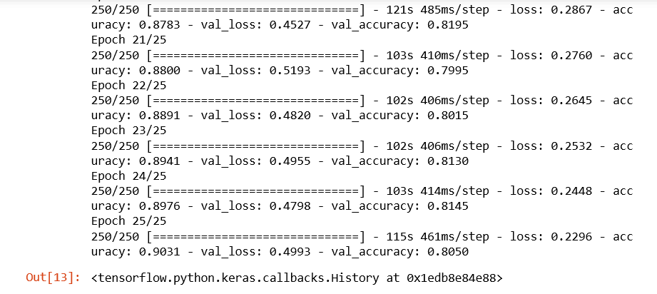
Output :
From the image given above, it can be seen that we ended with 90% of final accuracy on the training set and final accuracy of 80.50%on the test set. Let's remind it again that if we had not done image augmentation preprocessing in part1, we would have ended up with an accuracy of around 98% or even 99% on the training set, which clearly indicates overfitting and lower accuracy here on the test set around 70%. This is the reason why we insisted image augmentation is absolutely fundamental.

Slide 31
Part4: Making a single prediction:
In part4, we will make a single prediction, which actually consists of deploying our model on the two separate images of this single prediction folder for which our model will have to recognize for both the dog and cat, respectively. So, basically, we will deploy our CNN model on each of these single images, and we will hope that our CNN successfully predicts a dog as well as a cat. And for this, we will start with importing NumPy.
Next, we will import a new module that we actually imported earlier, i.e., we imported the ImageDataGenerator from the image submodule of the preprocessing module of the Keras library.
And in fact, what we are going to import now is that image module. But because we specifically imported something specific from that module, well, we need to import it again.
So, we will start with Keras, which we will help us to get access to the preprocessing module from which we will further import that image module. The next is, of course, to load that single image on which we want to deploy our model to predict if there is a cat or dog inside.
We will create a new variable, i.e., the test_set that will be initialized with loading the image on which we want to test out model from the same single prediction folder.

Slide 32
It can be done by first calling the image submodule from which we will call the load_img function, and inside this function, we will simply pass two arguments, i.e., the first parameter is the path specifying that particular image we want to select which will actually lead us to the test_set image variable and the second one plays a vital role as it relates to the image which will become the input of the predict method has to have the same size as the one that was used during the training.
Since we actually resized our images into the size target of (64, 64), whether it was for the training set or test set and we also specify it again while building the CNN with the same input shape, so the size of the image we are going to work with either for training the CNN or calling the predict method has to be (64, 64). So, in order to specify it here, we will enter our second parameter, which is the target_size.
import numpy as np
from keras.preprocessing import image
test_image = image.load_img('dataset/single_prediction/cat_or_dog_1.jpg', target_size = (64, 64))

Slide 33
But to make our first test _set image accepted by the predict method, we need to convert the format of an image into an array because the predict method expects its input to be a 2D array. And we will do this with the help of another function of the image preprocessing module, i.e., img_to_array function, which indeed converts PIL image instance into a NumPy array that is exactly the format of array expected by the predict method. We will again use our image submodule from which we will call img_to_array(), and inside, it will take the test_size image in PIL format that we are looking forward to convert it into the NumPy array format.
test_image = image.img_to_array(test_image)
Since the predict method has to be called on the exact same format that was used during the training, so if we go back into the preprocessing phase of both training set as well as the test set, we created batches of images. Therefore, our CNN was not trained in any single image; rather, it was trained on the batches of images. So, as we have an extra dimension of batch and we are about to deploy our model on a single image, then that single image still has to be into the batch even if we are going to have one image in the batch, it has to be into this batch so that the predict method of our CNN model can recognize the batch as that extra dimension.

Slide 34
Next, we will add an extra dimension, which will correspond to the batch that will contain that image into the batch, and it can be simply done by updating our test image by adding extra dimensions corresponding to batch.
And the way to do it is with NumPy as the NumPy arrays can be easily manipulated, so we will first call the NumPy from which we will call this function that allows exactly to add a fake dimension, or we can say a dimension corresponding to the batch, which is called expand_dims function inside of which we will input the image to which we want to add this extra dimension corresponding to the batch followed by adding an extra argument, i.e., where we want to add that extra dimension such that the dimension of the batch is always the first dimension to which we always give our first batch of images, and then inside of each batch we get the different images.
So, it seems natural to have the batch as the first dimension and to specify this is exactly what we need to enter as a second argument, which is an axis that we have to set equal to zero. That is why the dimension of a batch that we want to add to our image will be the first dimension.
test_image = np.expand_dims(test_image, axis = 0)

Slide 35
After this, we can call the predict method because, indeed, that test set image, which is not only in the right NumPy array but also which has the extra dimension corresponding to the batch, has exactly the right format expected by the predict method.
Therefore, we can create a new variable which will call result as it will actually predict our CNN model with the test image. Here we are not calling it prediction because it will only return or zero or one, which is why we are required to encode so as to represent 0 relates to cat and 1 is a dog. So, we will call our first result variable, which will actually be the output of the predict method called from our CNN.
Inside the predict method, we will pass the test_image, which now has the right format expected by that predict method.
result = cnn.predict(test_image)

Slide 36
To figure out in between what relates to 0 and what narrates about 1, we will call either the training_set or test_set and then from which we will further call class_indices, such that by printing this, we will get the right class_indices. And with this, we indeed get that dog corresponds to 1 and cat relates to 0.
training_set.class_indices
In the end, when the two single predictions are made on these two single images, we will finish it with the if condition. Since we already know that result contains the outcome in batches because it was called on a test image that was into a batch, so results also have a batch dimension, and we are going to get access to the batch.

Slide 37
After this, inside the batch, we are going to get access to the first element of the batch that corresponds to the prediction of that same cat_or_dog_1 image.
As we are dealing with a single image, so a single prediction is needed, and to get that, we will need to get inside the batch of index zero, the first and only prediction once again, which has a [0] index. So, that is how we get our prediction by first accessing the batch followed by accessing the single element of the batch, and if that prediction equals to one, then we already know that it corresponds to the dog, then we will create a new variable which we will call as prediction and will set that prediction variable equals to the dog. Likewise, in the else condition, if the result prediction equals to 1, then the prediction will be a cat. Now we will wrap it up by simply printing the prediction.
if result[0][0] == 1:
prediction = 'dog'
else:
prediction = 'cat'
print(prediction)

Slide 38
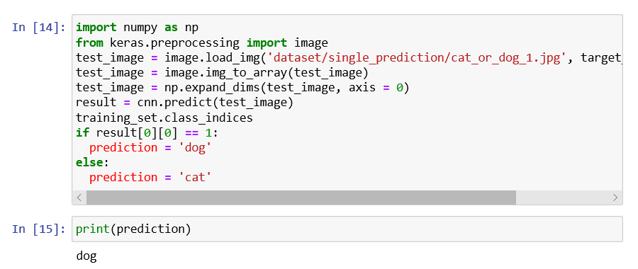
Output:

Slide 39
We can see our Convolution Neural Network predicted that there is a dog inside the image. So, it can be concluded that our first test is passed successfully.
Now we will check for the other image which is of the cat, so for that we will need to deploy our model on this single image and check that indeed, our CNN returns a cat. To do this, we need to change the name here, i.e. cat_or_dog_2.jpg and then play this cell again by clicking on the Run button.
import numpy as np
from keras.preprocessing import image
test_image = image.load_img('dataset/single_prediction/cat_or_dog_2.jpg', target_size = (64, 64))
test_image = image.img_to_array(test_image)
test_image = np.expand_dims(test_image, axis = 0)
result = cnn.predict(test_image)
training_set.class_indices
if result[0][0] == 1:
prediction = 'dog'
else:
prediction = 'cat'
print(prediction)

Slide 40
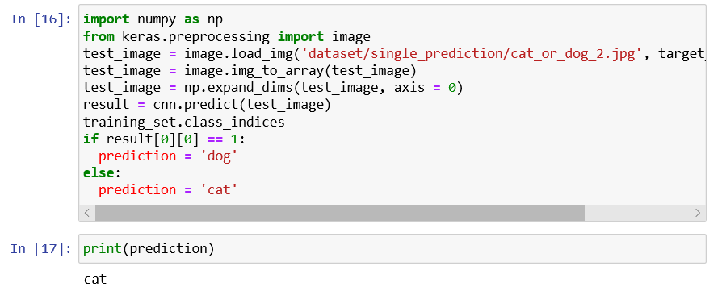
Output:
So, it's clear now that our CNN model is successful in predicting cat in the output of the console. Hence our CNN got all the answers correct.

Slide 41
CASE STUDY :
Dog vs Cat Convolution Neural Network Classifier
Problem statement :
In this Section we are implementing Convolution Neural Network(CNN) Classifier for Classifying dog and cat images. The Total number of images available for training is 25,000 and final testing is done on seperate 10,000 images.
Jupyter notebook
Tensorflow 1.10
Python 3.6
Matplotlib
Seaborn
Scikit-Learn
Pandas
Numpy
Install dependencies using conda

Slide 42
Test Train Split
Image training set contain 12500 images for each category. I split those into 80% train and 20% means test Split each class images into 10,000 for train and 2,500 for test.
from tensorflow.keras.models import Sequential
from tensorflow.keras.layers import Flatten
from tensorflow.keras.layers import Dense
from tensorflow.keras.layers import Conv2D
from tensorflow.keras.layers import MaxPooling2D
from tensorflow.keras.callbacks import TensorBoard
from warnings import filterwarnings
filterwarnings('ignore')

Slide 43
Network Parameter:
Rectifier Linear Unit
Adam optimizer
Sigmoid on Final output
Binary CrossEntropy loss
classifier = Sequential()
classifier.add(Conv2D(32,(3,3),input_shape=(64,64,3),activation = 'relu'))
classifier.add(MaxPooling2D(pool_size=(2,2),strides=2)) #if stride not given it equal to pool filter size
classifier.add(Conv2D(32,(3,3),activation = 'relu'))
classifier.add(MaxPooling2D(pool_size=(2,2),strides=2))
classifier.add(Flatten())
classifier.add(Dense(units=128,activation='relu'))
classifier.add(Dense(units=1,activation='sigmoid'))
adam = tensorflow.keras.optimizers.Adam(lr=0.001, beta_1=0.9, beta_2=0.999, epsilon=None, decay=0.0, amsgrad=False)
classifier.compile(optimizer=adam,loss='binary_crossentropy',metrics=['accuracy’])
#tensorboard = TensorBoard(log_dir="logs/{}".format(time()))

Slide 44
Data Augmentation
Using some Data Augmentation techniques for more data and Better results.
Shearing of images
Random zoom
Horizontal flips
from tensorflow.keras.preprocessing.image import ImageDataGenerator
train_datagen = ImageDataGenerator(rescale=1./255,
shear_range=0.1,
zoom_range=0.1,
horizontal_flip=True)
test_datagen = ImageDataGenerator(rescale=1./255)

Slide 45
#Training Set
train_set = train_datagen.flow_from_directory('train',
target_size=(64,64),
batch_size=32,
class_mode='binary')
#Validation Set
test_set = test_datagen.flow_from_directory('test',
target_size=(64,64),
batch_size = 32,
class_mode='binary',
shuffle=False)

Slide 46
#Test Set /no output available
test_set1 = test_datagen.flow_from_directory('test1',
target_size=(64,64),
batch_size=32,
shuffle=False)
OUTPUT:
Found 19998 images belonging to 2 classes.
Found 5000 images belonging to 2 classes.
Found 12500 images belonging to 1 classes.
%%capture
classifier.fit_generator(train_set,
steps_per_epoch=800,
epochs = 200,
validation_data = test_set,
validation_steps = 20,
#callbacks=[tensorboard]
);

Slide 47
#Some Helpful Instructions:
#finetune you network parameter in last by using low learning rate like 0.00001
#classifier.save('resources/dogcat_model_bak.h5')
#from tensorflow.keras.models import load_model
#model = load_model('partial_trained1')
#100 iteration with learning rate 0.001 and after that 0.0001
from tensorflow.keras.models import load_model
classifier = load_model('resources/dogcat_model_bak.h5')

Slide 48
#Prediction of image
%matplotlib inline
import tensorflow
from tensorflow.keras.preprocessing import image
import matplotlib.pyplot as plt
import numpy as np
img1 = image.load_img('test/Cat/10.jpg', target_size=(64, 64))
img = image.img_to_array(img1)
img = img/255
# create a batch of size 1 [N,H,W,C]
img = np.expand_dims(img, axis=0)
prediction = classifier.predict(img, batch_size=None,steps=1) #gives all class prob.
if(prediction[:,:]>0.5):
value ='Dog :%1.2f'%(prediction[0,0])
plt.text(20, 62,value,color='red',fontsize=18,bbox=dict(facecolor='white',alpha=0.8))
else:
value ='Cat :%1.2f'%(1.0-prediction[0,0])
plt.text(20, 62,value,color='red',fontsize=18,bbox=dict(facecolor='white',alpha=0.8))
plt.imshow(img1)
plt.show()

Slide 49
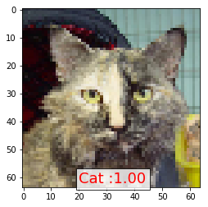
Output :

Slide 50
import pandas as pd
test_set.reset
ytesthat = classifier.predict_generator(test_set)
df = pd.DataFrame({
'filename':test_set.filenames,
'predict':ytesthat[:,0],
'y':test_set.classes
})
pd.set_option('display.float_format', lambda x: '%.5f' % x)
df['y_pred'] = df['predict']>0.5
df.y_pred = df.y_pred.astype(int)
df.head(10)

Slide 51
filename | predict | y | y_pred
0 | Cat/0.jpg | 0.00000 | 0 | 0
1 | Cat/1.jpg | 0.00000 | 0 | 0
2 | Cat/10.jpg | 0.00000 | 0 | 0
3 | Cat/100.jpg | 0.99970 | 0 | 1
4 | Cat/10001.jpg | 0.00000 | 0 | 0
5 | Cat/10009.jpg | 0.02340 | 0 | 0
6 | Cat/1001.jpg | 0.00001 | 0 | 0
7 | Cat/10012.jpg | 0.00000 | 0 | 0
8 | Cat/10017.jpg | 0.00000 | 0 | 0
9 | Cat/10018.jpg | 0.00000 | 0 | 0

Slide 52
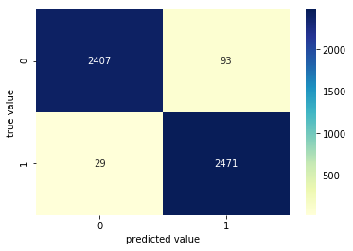
misclassified = df[df['y']!=df['y_pred']]
print('Total misclassified image from 5000 Validation images : %d'%misclassified['y'].count())
Total misclassified image from 5000 Validation images : 122
#Prediction of test set
from sklearn.metrics import confusion_matrix
import matplotlib.pyplot as plt
import seaborn as sns
conf_matrix = confusion_matrix(df.y,df.y_pred)
sns.heatmap(conf_matrix,cmap="YlGnBu",annot=True,fmt='g');
plt.xlabel('predicted value')
plt.ylabel('true value');

Slide 53
#Some of Cat image misclassified as Dog.
import matplotlib.image as mpimg
CatasDog = df['filename'][(df.y==0)&(df.y_pred==1)]
fig=plt.figure(figsize=(15, 6))
columns = 7
rows = 3
for i in range(columns*rows):
#img = mpimg.imread()
img = image.load_img('test/'+CatasDog.iloc[i], target_size=(64, 64))
fig.add_subplot(rows, columns, i+1)
plt.imshow(img)
plt.show()

Slide 54
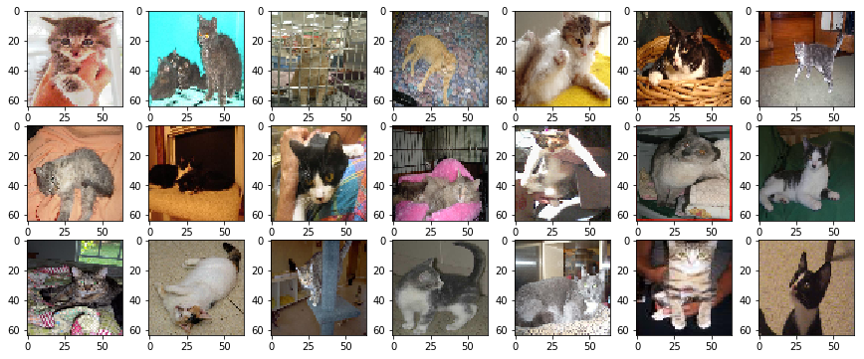

Slide 55
#Some of Dog image misclassified as Cat.
import matplotlib.image as mpimg
DogasCat = df['filename'][(df.y==1)&(df.y_pred==0)]
fig=plt.figure(figsize=(15, 6))
columns = 7
rows = 3
for i in range(columns*rows):
#img = mpimg.imread()
img = image.load_img('test/'+DogasCat.iloc[i], target_size=(64, 64))
fig.add_subplot(rows, columns, i+1)
plt.imshow(img)
plt.show()

Slide 56
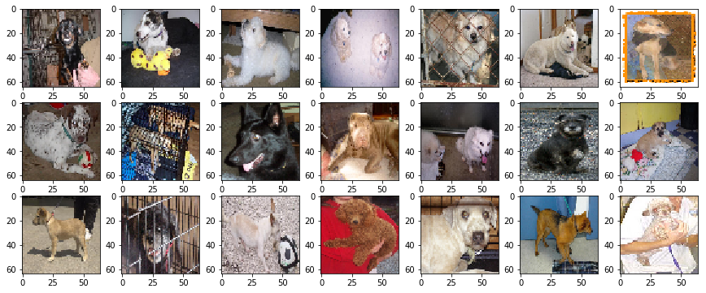

Slide 57
classifier.summary()
_________________________________________________________________
Layer (type) Output Shape Param #
=================================================================
conv2d_6 (Conv2D) (None, 62, 62, 32) 896
_________________________________________________________________
max_pooling2d_6 (MaxPooling2 (None, 31, 31, 32) 0
_________________________________________________________________
conv2d_7 (Conv2D) (None, 29, 29, 32) 9248
_________________________________________________________________
max_pooling2d_7 (MaxPooling2 (None, 14, 14, 32) 0
_________________________________________________________________
flatten_3 (Flatten) (None, 6272) 0
_________________________________________________________________
dense_6 (Dense) (None, 128) 802944
_________________________________________________________________
dense_7 (Dense) (None, 1) 129
=================================================================
Total params: 813,217
Trainable params: 813,217
Non-trainable params: 0
_________________________________________________________________

Slide 58
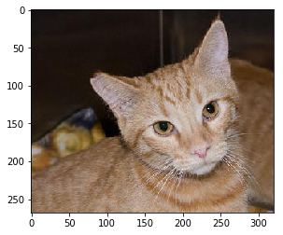
Visualization of Layers Ouptut
#Input Image for Layer visualization
img1 = image.load_img('test/Cat/14.jpg')
plt.imshow(img1);
#preprocess image
img1 = image.load_img('test/Cat/14.jpg', target_size=(64, 64))
img = image.img_to_array(img1)
img = img/255
img = np.expand_dims(img, axis=0)

Slide 59
model_layers = [ layer.name for layer in classifier.layers]
print('layer name : ',model_layers)
layer name : ['conv2d_6', 'max_pooling2d_6', 'conv2d_7', 'max_pooling2d_7', 'flatten_3', 'dense_6', 'dense_7’]
from tensorflow.keras.models import Model
conv2d_6_output = Model(inputs=classifier.input, outputs=classifier.get_layer('conv2d_6').output)
conv2d_7_output = Model(inputs=classifier.input,outputs=classifier.get_layer('conv2d_7').output)
conv2d_6_features = conv2d_6_output.predict(img)
conv2d_7_features = conv2d_7_output.predict(img)
print('First conv layer feature output shape : ',conv2d_6_features.shape)
print('First conv layer feature output shape : ',conv2d_7_features.shape)
Output :
First conv layer feature output shape : (1, 62, 62, 32)
First conv layer feature output shape : (1, 29, 29, 32)

Slide 60
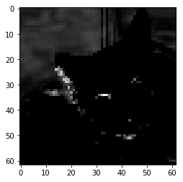
Single Convolution Filter Output:
plt.imshow(conv2d_6_features[0, :, :, 4], cmap='gray’)
Plt.show()

Slide 61
First Covolution Layer Output
import matplotlib.image as mpimg
fig=plt.figure(figsize=(14,7))
columns = 8
rows = 4
for i in range(columns*rows):
#img = mpimg.imread()
fig.add_subplot(rows, columns, i+1)
plt.axis('off')
plt.title('filter'+str(i))
plt.imshow(conv2d_6_features[0, :, :, i], cmap='gray')
plt.show()

Slide 62
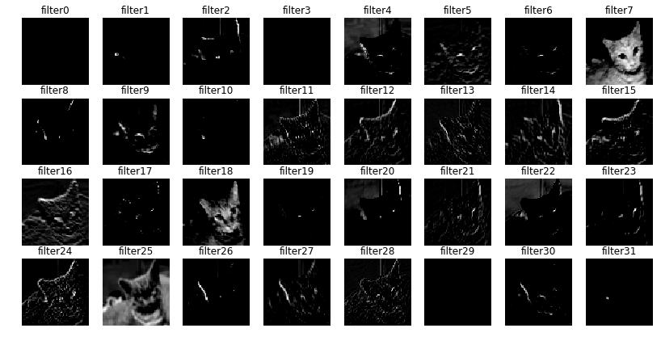

Slide 63
Second Covolution Layer Output
fig=plt.figure(figsize=(14,7))
columns = 8
rows = 4
for i in range(columns*rows):
#img = mpimg.imread()
fig.add_subplot(rows, columns, i+1)
plt.axis('off')
plt.title('filter'+str(i))
plt.imshow(conv2d_7_features[0, :, :, i], cmap='gray')
plt.show()

Slide 64
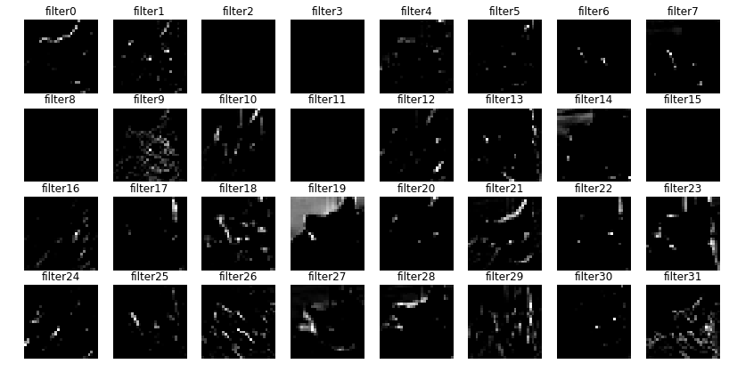

Slide 65
Model Performance on Unseen Data:
# for generator image set u can use
# ypred = classifier.predict_generator(test_set)
fig=plt.figure(figsize=(15, 6))
columns = 7
rows = 3
for i in range(columns*rows):
fig.add_subplot(rows, columns, i+1)
img1 = image.load_img('test1/'+test_set1.filenames[np.random.choice(range(12500))], target_size=(64, 64))
img = image.img_to_array(img1)
img = img/255
img = np.expand_dims(img, axis=0)
prediction = classifier.predict(img, batch_size=None,steps=1) #gives all class prob.
if(prediction[:,:]>0.5):
value ='Dog :%1.2f'%(prediction[0,0])
plt.text(20, 58,value,color='red',fontsize=10,bbox=dict(facecolor='white',alpha=0.8))
else:
value ='Cat :%1.2f'%(1.0-prediction[0,0])
plt.text(20, 58,value,color='red',fontsize=10,bbox=dict(facecolor='white',alpha=0.8))
plt.imshow(img1)

Slide 66
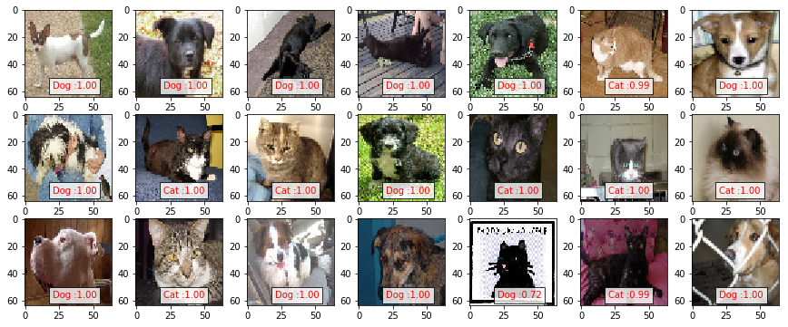

Slide 67
%%capture
# Model Accuracy
x1 = classifier.evaluate_generator(train_set)
x2 = classifier.evaluate_generator(test_set)
print('Training Accuracy : %1.2f%% Training loss : %1.6f'%(x1[1]*100,x1[0]))
print('Validation Accuracy: %1.2f%% Validation loss: %1.6f'%(x2[1]*100,x2[0]))
Training Accuracy : 99.96% Training loss : 0.002454
Validation Accuracy: 97.56% Validation loss: 0.102678
Conclusion:
The Architecture and parameter used in this network are capable of producing accuracy of 97.56% on Validation Data which is pretty good. It is possible to Achieve more accuracy on this dataset using deeper network and fine tuning of network parameters for training. You can download this trained model from resource directory and Play with it.

Slide 68
THE END

